Slide 1

Abschlusspräsentation –
Implementierung einer Lambda Architektur
Lars Grespan
Bildquelle: https://www.pexels.com/photo/low-angle-shot-of-high-rise-building-2096578/

Slide 2
Implementierung einer Lambda-Architektur
AGENDA
Problemstellung – Ausgangssituation
Definitionen – IS strategic Leadership, CIO, IS Quality, IS Vision, Organizational Benefits
Hypothesen – Zusammenspiel IS strategic Leadership, IS Quality, IS Vision,
Organizational Benefits
Outcome – Ergebnisse der Studie
Quiz & Fragen

Slide 3

Problemstellung
Bildquelle: https://www.pexels.com/photo/black-and-white-blackboard-business-chalkboard-356043/

Slide 4

Architektur
Bildquelle: https://www.pexels.com/photo/clear-light-bulb-on-black-surface-356043/

Slide 5
Architecture
Event Processing System
Data Scientist
Event Processing System
[Software System]
The event processing system is responsible for generating data, simulating test stations, processing events, training and creating ML models, generating predictions, displaying predictions and displaying the results.
Trains ML-models
Quality Engineer
Views prediction results

Slide 6
Architecture
REST Implementation
Data model
[Component: Python]
Test station meta information
Creates Data Model
Data Scientist
Loads Data Model
Starts event generation
Event generation
[Container: Python]
Event data generation
EventDB
[Container: MongoDB]
Stores created events
Starts test station event simulation
Reads and writes csv files
Reads and writes processed events
Simulate test stations
[Container: Python]
Sending Events from the test stations
Reads events
Starts REST Webservice
Event processing
[Component: Python]
Processing of events
Performs ML Model training
Reads and writes results
Makes REST API Calls
Processing server
[Container: Python]
REST Webservice to receive events, make predictions and to show the results
Processes received events
Quality Engineer
Views results on the website [https]
Reads events
Loads ML models
Processes events
File System
[Container: Local Directory]
Model training
[Container: Python]
ML Model training
Stores ML models
Event Processing System [Software System]

Slide 7
Architecture
Change Streams Implementation
Data Model
[Component: Python]
Test station meta information
(Create csv-files)
Creates Data Model
Event generation
[Container: Python]
Event data generation
(Create csv-files)
Loads Data Model
Starts event generation
Stores created events
EventDB
[Container: MongoDB]
Data Scientist
Reads and writes csv files
Starts test station event simulation
Simulate test stations
[Container: Python]
Test station event creation
Reads events
Reads and writes results
Reads and writes processed events
Starts change streams service
Reads csv files
Trigger change streams service
Event processing
[Component: Python]
Processing of events
Change Streams Service
[Container: Python]
React on an event creation (make predictions)
Starts REST Webservice
Processes events
Performs ML Model training
Reads events
Loads ML models
Quality Engineer
Result presentation
[Container: Python]
Webservice to show the results
Views results on the website [https]
Reads events
File System
[Container: Local Directory]
Processes events
Model training
[Container: Python]
ML Model training
Stores ML models
Event Processing System [Software System]

Slide 8
Architecture
Event Generation (REST + Change Streams)
Start Data Generation
[Component: Python]
Pass CMD arguments to datagen script
Data Generation
[Component: Python]
csv- file creation
Creates csv files using CMD arguments
Saves csv-files reads config files
File System
[Container: Local Directory]
Starts event generation CMD arguments: config file name, number of events, csv-file name
Test station config
[Component: Yaml]
Config file for creating test station data set
Saves files on local directory
Data Scientist
Creates config files
EventDB
[Container: MongoDB]
Reads csv files
Starts storing process
Store events
Store Data
[Component: Python]
Stores dependent events
Create Dependencies
[Component: Python]
Creates dependencies among the different csv-files
Calls create_dependencies script
Event generation [Container]

Slide 9
Architecture
Model Training (REST + Change Streams)
ML Model Training
[Component: Python]
Trains ML models with processed events and loaded label
File System
[Container: Local Directory]
Saves ML models
Calls ML model training
Start Batch Training
[Component: Python]
Pass CMD arguments and triggers batch ML model training
Event processing
[Container: Python]
Processing of events
Data Scientist
Performs batch ML model training CMD arguments: teststation, product_type
Calls event processing
Calls Load Label
Reads events
Load Label
[Component: Python]
Load Label from the processed events from the next test station
EventDB
[Container: MongoDB]
Reads processed events
Model training [Container]

Slide 10
Architecture
Event Processing (REST + Change Streams)
Clean Events
[Function: Python]
Data Model
[Component: Python]
Meta information for deviating features and cleaning data
Change Streams Service
[Container: Python]
React on an event creation (make predictions)
Gets drop list
Creates Data Model
Data Scientist
Calls pre-processing
Gets feature and value dict
Processing Server
[Container: Python]
REST Webservice to receive events, make predictions and to show the results
Process Events
[Function: Python]
Pass CMD arguments and triggers batch ML model training
Derive Events
[Function: Python]
Calls event
Calls derivation
Calls Store Data
Calls event
Store Events
[Function: Python]
Calls merge events
Model training
[Container: Python]
ML Model training
Merge Events
[Function: Python]
Merge Events among test stations
Writes events
EventDB
[Container: MongoDB]
Reads and writes events
Event Processing [Container]

Slide 11
Architecture
Simulate Test Stations (REST)
Start sending Events
[Component: Python]
Pass CMD arguments and start sending event to REST Server procedure
Starts test station event simulation CMD arguments: teststation, product_type
Reads events
Data Scientist
EventDB
[Container: MongoDB]
Calls rest script to send events
Send to REST Server
[Component: Python]
Loop over events in consideration of CMD arguments) and send them to the REST Server
Simulate test stations [Container]
Makes REST API Calls
Processing Server
[Container: Python]
REST Webservice to receive events, make predictions and to show the results

Slide 12
Architekture
Simulate Test Stations (Change Streams)
Create Dependencies
[Component: Python]
Creates dependencies among the different csv-files
Calls create_dependencies
Store Data
[Component: Python]
Stores dependent events
EventDB
[Container: MongoDB]
Data Scientist
Starts test station event simulation
Stores events
Reads csv files
Triggers response of change streams service
File System
[Container: Local Directory]
Simulate test stations Container]
Change Streams Service
[Container: Python]
React on an event creation (make predictions)

Slide 13
Architecture
Processing Server (REST)
Simulate test stations
[Container: Python]
Sending Events from the test stations
File System
[Container: Local Directory]
Makes REST API calls
Loads ML Models
Data Scientist
Start REST Server
[Component: Python]
Start Server and pass CMD arguments
Process Events Service
[Component: Python]
Receive events, load corresponding ML models and make predictions
Starts server CMD arguments: teststation, product_type
Starts service
Calls event processing
Event processing
[Container: Python]
Processing of events
Starts service
Saves prediction results
Show Results Service
[Component: Python]
Create Website with result table
Quality Engineer
Views results [https]
Reads results
EventDB
[Container: MongoDB]
Processing Server [Container]

Slide 14
Architecture
Change Streams Service (Change Streams)
Simulate test stations
[Container: Python]
Test station event creation
File System
[Container: Local Directory]
Trigger change
stream service
Loads ML Models
Data Scientist
Start Change Stream Service
[Component: Python]
Start Change Stream Service. Pass CMD arguments
Change Stream Service
[Component: Python]
Receive events, process events (in consideration of the CMD arguments),
load corresponding ML models and make predictions
Event processing
[Container: Python]
Processing of events
Starts server CMD arguments: teststation, product_type
Starts service
Calls event processing script
Saves prediction results
EventDB
[Container: MongoDB]
Change Streams Service [Container]

Slide 15
Architecture
Result Presentation(Change Streams)
Start Webservice
[Component: Python]
Start Webservice
Data Scientist
Starts webservice
EventDB
[Container: MongoDB]
Starts service
Reads results
Show Results Service
[Component: Python]
Create Website with result table
Quality Engineer
Views results [https]
Result Presentation [Container]

Slide 16

Outcome
Bildquelle: https://www.pexels.com/photo/adult-books-business-coffee-374016/
Bildquelle: https://www.pexels.com/photo/iphone-notebook-pen-working-34088/
Bildquelle: https://gsp-architekten.de/projekt/microsoft-headquarter-deutschland-muenchen/

Slide 17
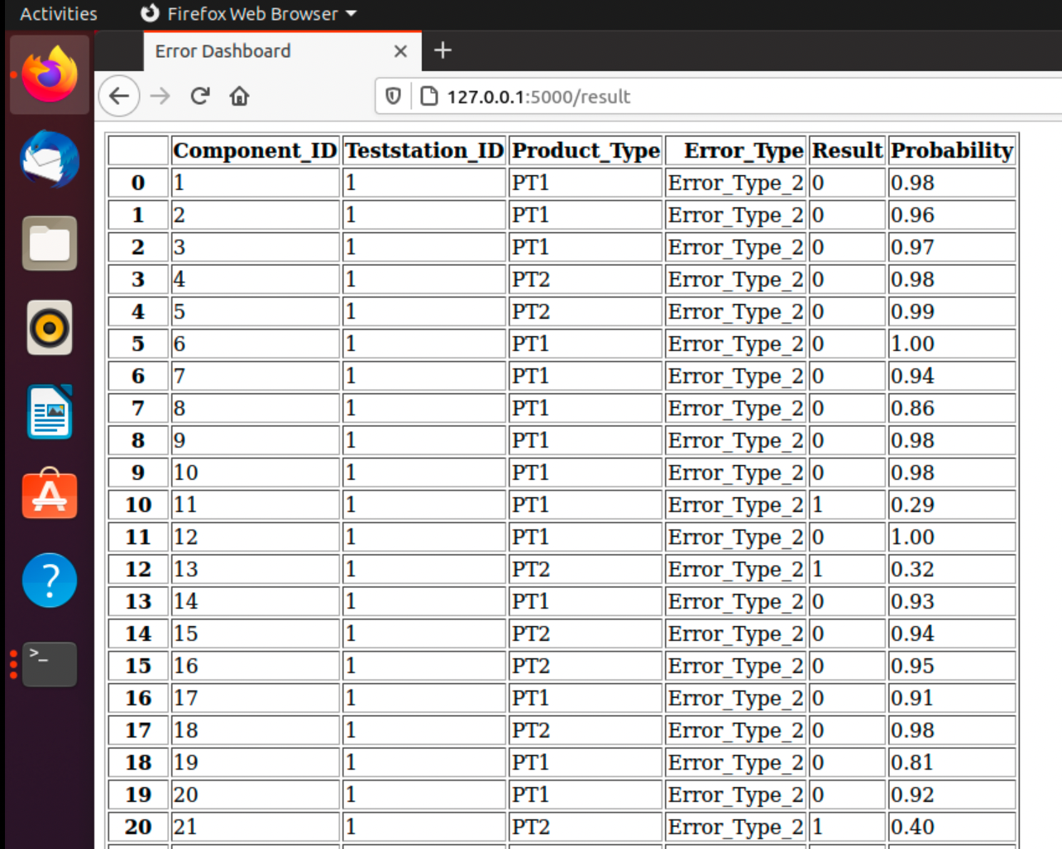
Outcome
Error Dashboard

Slide 18

Outcome
Fragen
Bildquelle: https://www.pexels.com/photo/adult-books-business-coffee-374016/
Bildquelle: https://www.pexels.com/photo/iphone-notebook-pen-working-34088/
Bildquelle: https://www.pexels.com/photo/adult-blur-business-close-up-239548/
Bildquelle: https://gsp-architekten.de/projekt/microsoft-headquarter-deutschland-muenchen/

Slide 19
KONTAKTIEREN SIE MICH
LARS GRESPAN
lars.grespan@hs-furtwangen.de
ICH FREUE MICH AUF IHRE NACHRICHT

